Slide 1
ALPHA
PYTHON – INTRODUCTION

Slide 2
INTRODUCTION
Brief history of python
Python installation
Path configuration
Pycharm installation
Compilation process in python

Slide 3
Brief history of python
Python was developed by Guido Van Rossum.
It was implemented in 1989

Slide 4
Python - Overview
Python is a very simple programming language.
It is very powerful object oriented programming language.
It is a widely used general-purpose, high level programming language.
It is an interpreter language.
It supports Dynamic memory allocation.

Slide 5
Features of Python
Readable syntax.
Easy to learn.
Free, Open source.
Cross platform.
Large standard library.

Slide 6
Python Installation
Steps:
Go to https://www.python.org/downloads/

Slide 7
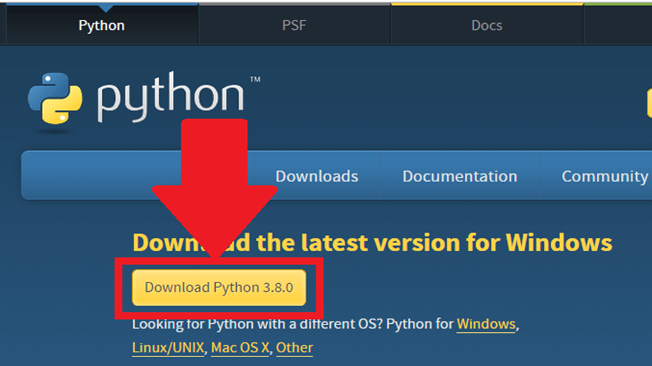

Slide 8
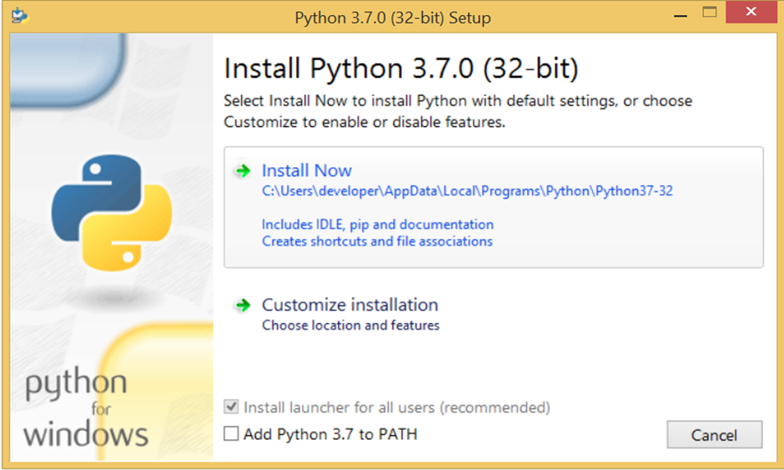

Slide 9
Setting path manually
My computer à Right click on This PC à properties à advanced system settings à Environment variables
Add python path(python folder and scripts) to both system and user variables.
If not customized the python path will be,
C:\Users\Admin\AppData\Local\Programs\Python\Python39

Slide 10
Pycharm Installation
Open https://www.jetbrains.com/pycharm/download/
Download community edition
Install it.

Slide 11
Compilation process in python
Python is called an interpreted language.
In cpython,
Required output
Source code (*.py)
Bytecode (*.pyc)
Compiler(Cpython)
Bytecode (*.pyc)
Interpreter(PVM)

